Slide 1
Practitioners as Writers
&
Writers as Practitioners
Mark Ingham
UAL Teaching Scholar
LCF JPS
Tuesday 24th April
2018

Slide 2
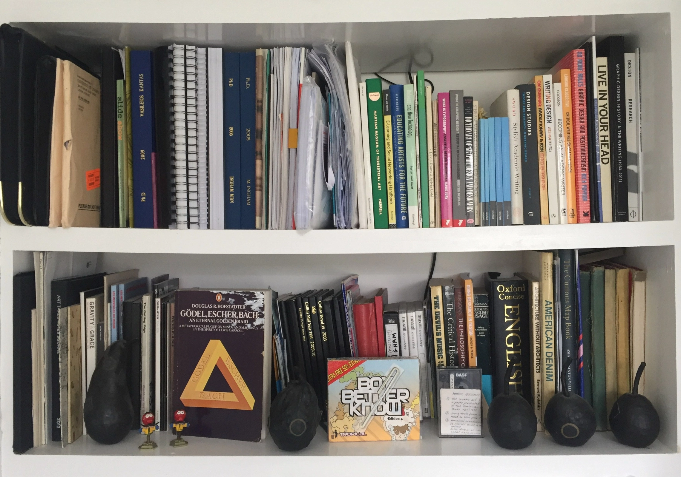

Slide 3
https://agentsagencyagenciesinassemblingliminallearningspaces.wordpress.com/

Slide 4
[Start]
Begin with a short Introduction to my practice-based research?
&
Writing Practice?
https://markingham.org/

Slide 5
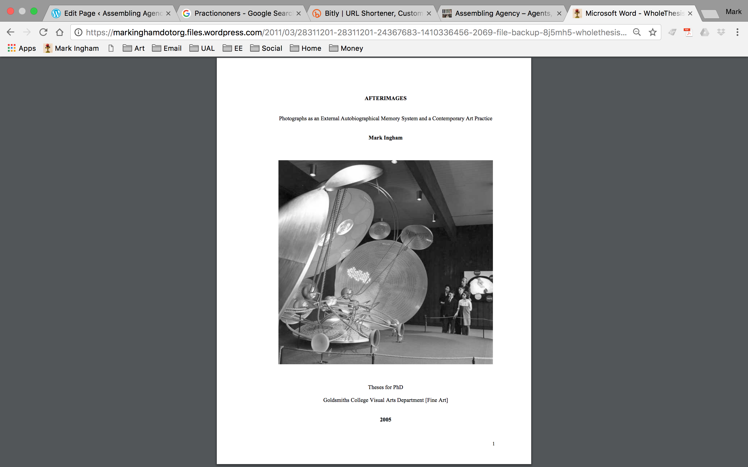

Slide 6
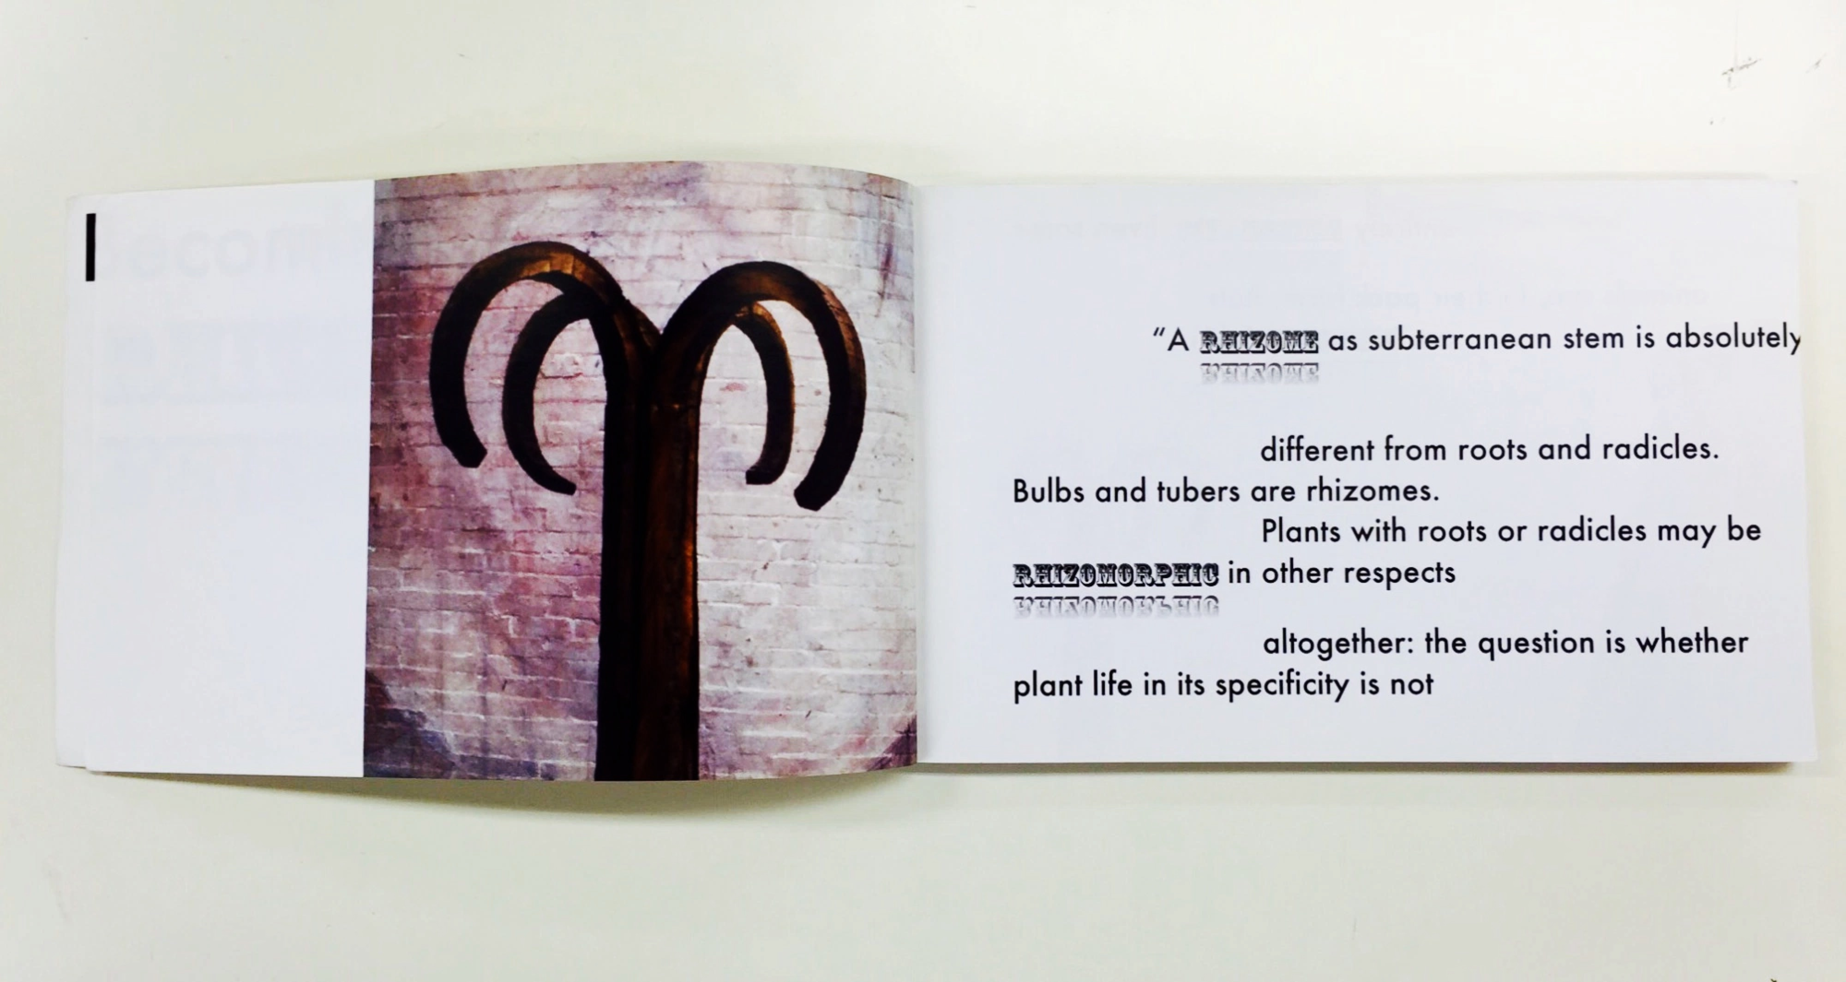

Slide 7
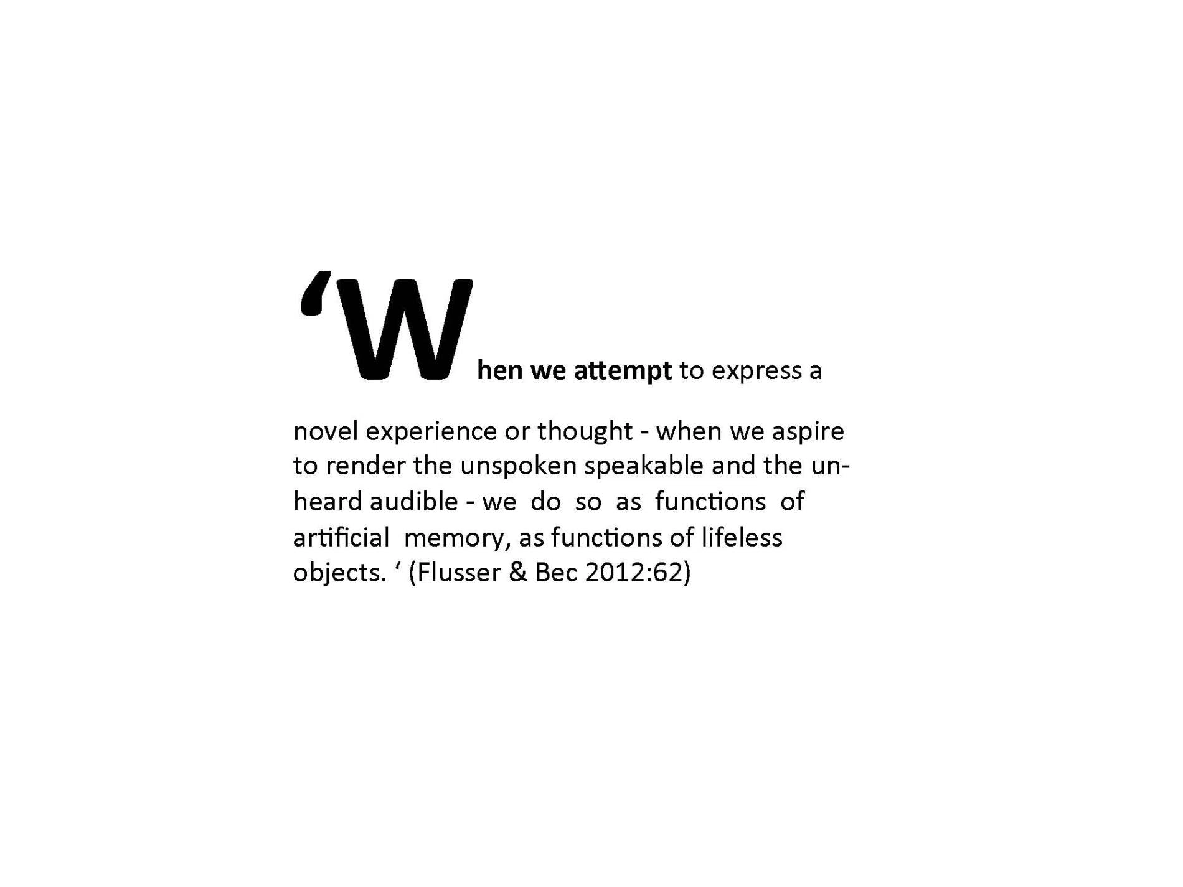

Slide 8
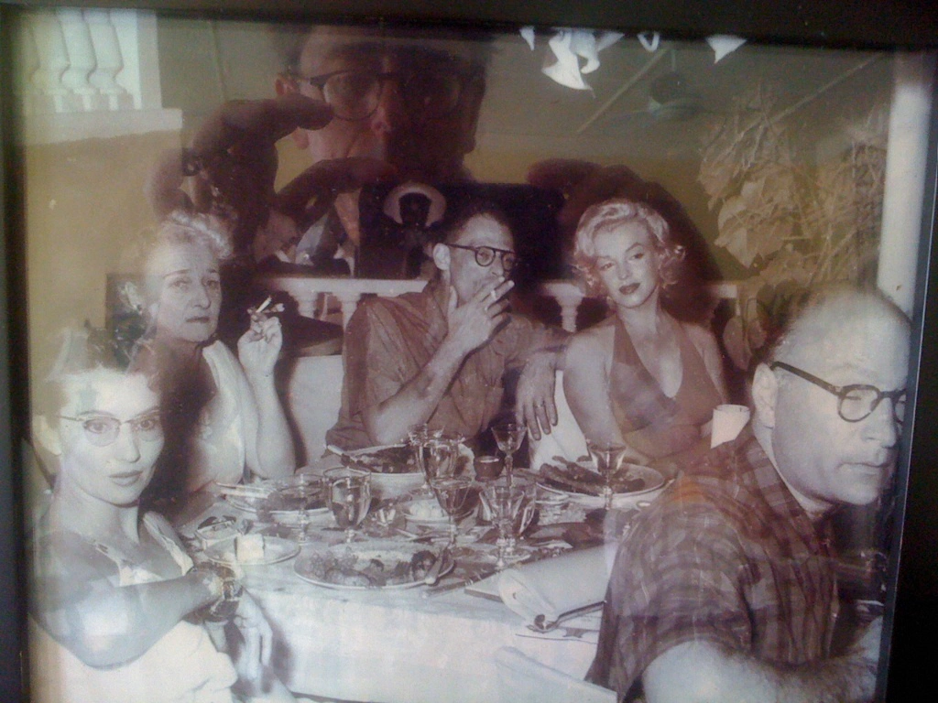

Slide 9
https://youtu.be/_JVqzdCtm3s

Slide 10


Slide 11
A look at the work of practitioners as writers such as Linda Stupart and her novella, Virus.
http://lindastupart.net/text.php

Slide 12
WHAT TO EXPECT IN THIS BOOK:
* tentacle sex
* Kathy Acker
* the violent deaths of male genius artists, philosophers and theorists
* zombies
* sirens
* biohacking
* rampant plagiarism
* cop killing
* spells you can use at home

Slide 13
Writing purposefully in art and design
Responding to converging and diverging new academic literacies
Gavin Melles & Julia Lockheart First Published April 12, 2012
http://journals.sagepub.com/doi/abs/10.1177/1474022211432116

Slide 14
‘Recently, for example, much has been written about the distinctiveness of practice-based, reflective and creative written genres, such as the exegesis and the studio or practice based thesis, as the distinctive voice of art and design. However, such models have yet to gain broad acceptance in the higher education sector, where scientific (e.g. empirical research report) and humanities (e.g. essayist tradition) practices are far more familiar and of overarching significance.’

Slide 15
An Anatomy of an Academic Essay

Slide 16
‘I am going to use the analogy of anatomy to help describe the structures of an academic essay and how its elements work and join together. This should help you structure your essay. Each part I write and send to you, will grow from the previous part, be fleshed out so to speak. It might be human like but could turn into and octopus, how it is formed is up to your imagination? You may have noticed that in writing and what you write on, the body is used to designate various parts. To name but a few: the preface, the body text, the header, the footer and spine.’

Slide 17
https://ctslccbagmd1.wordpress.com/category/essay/

Slide 18
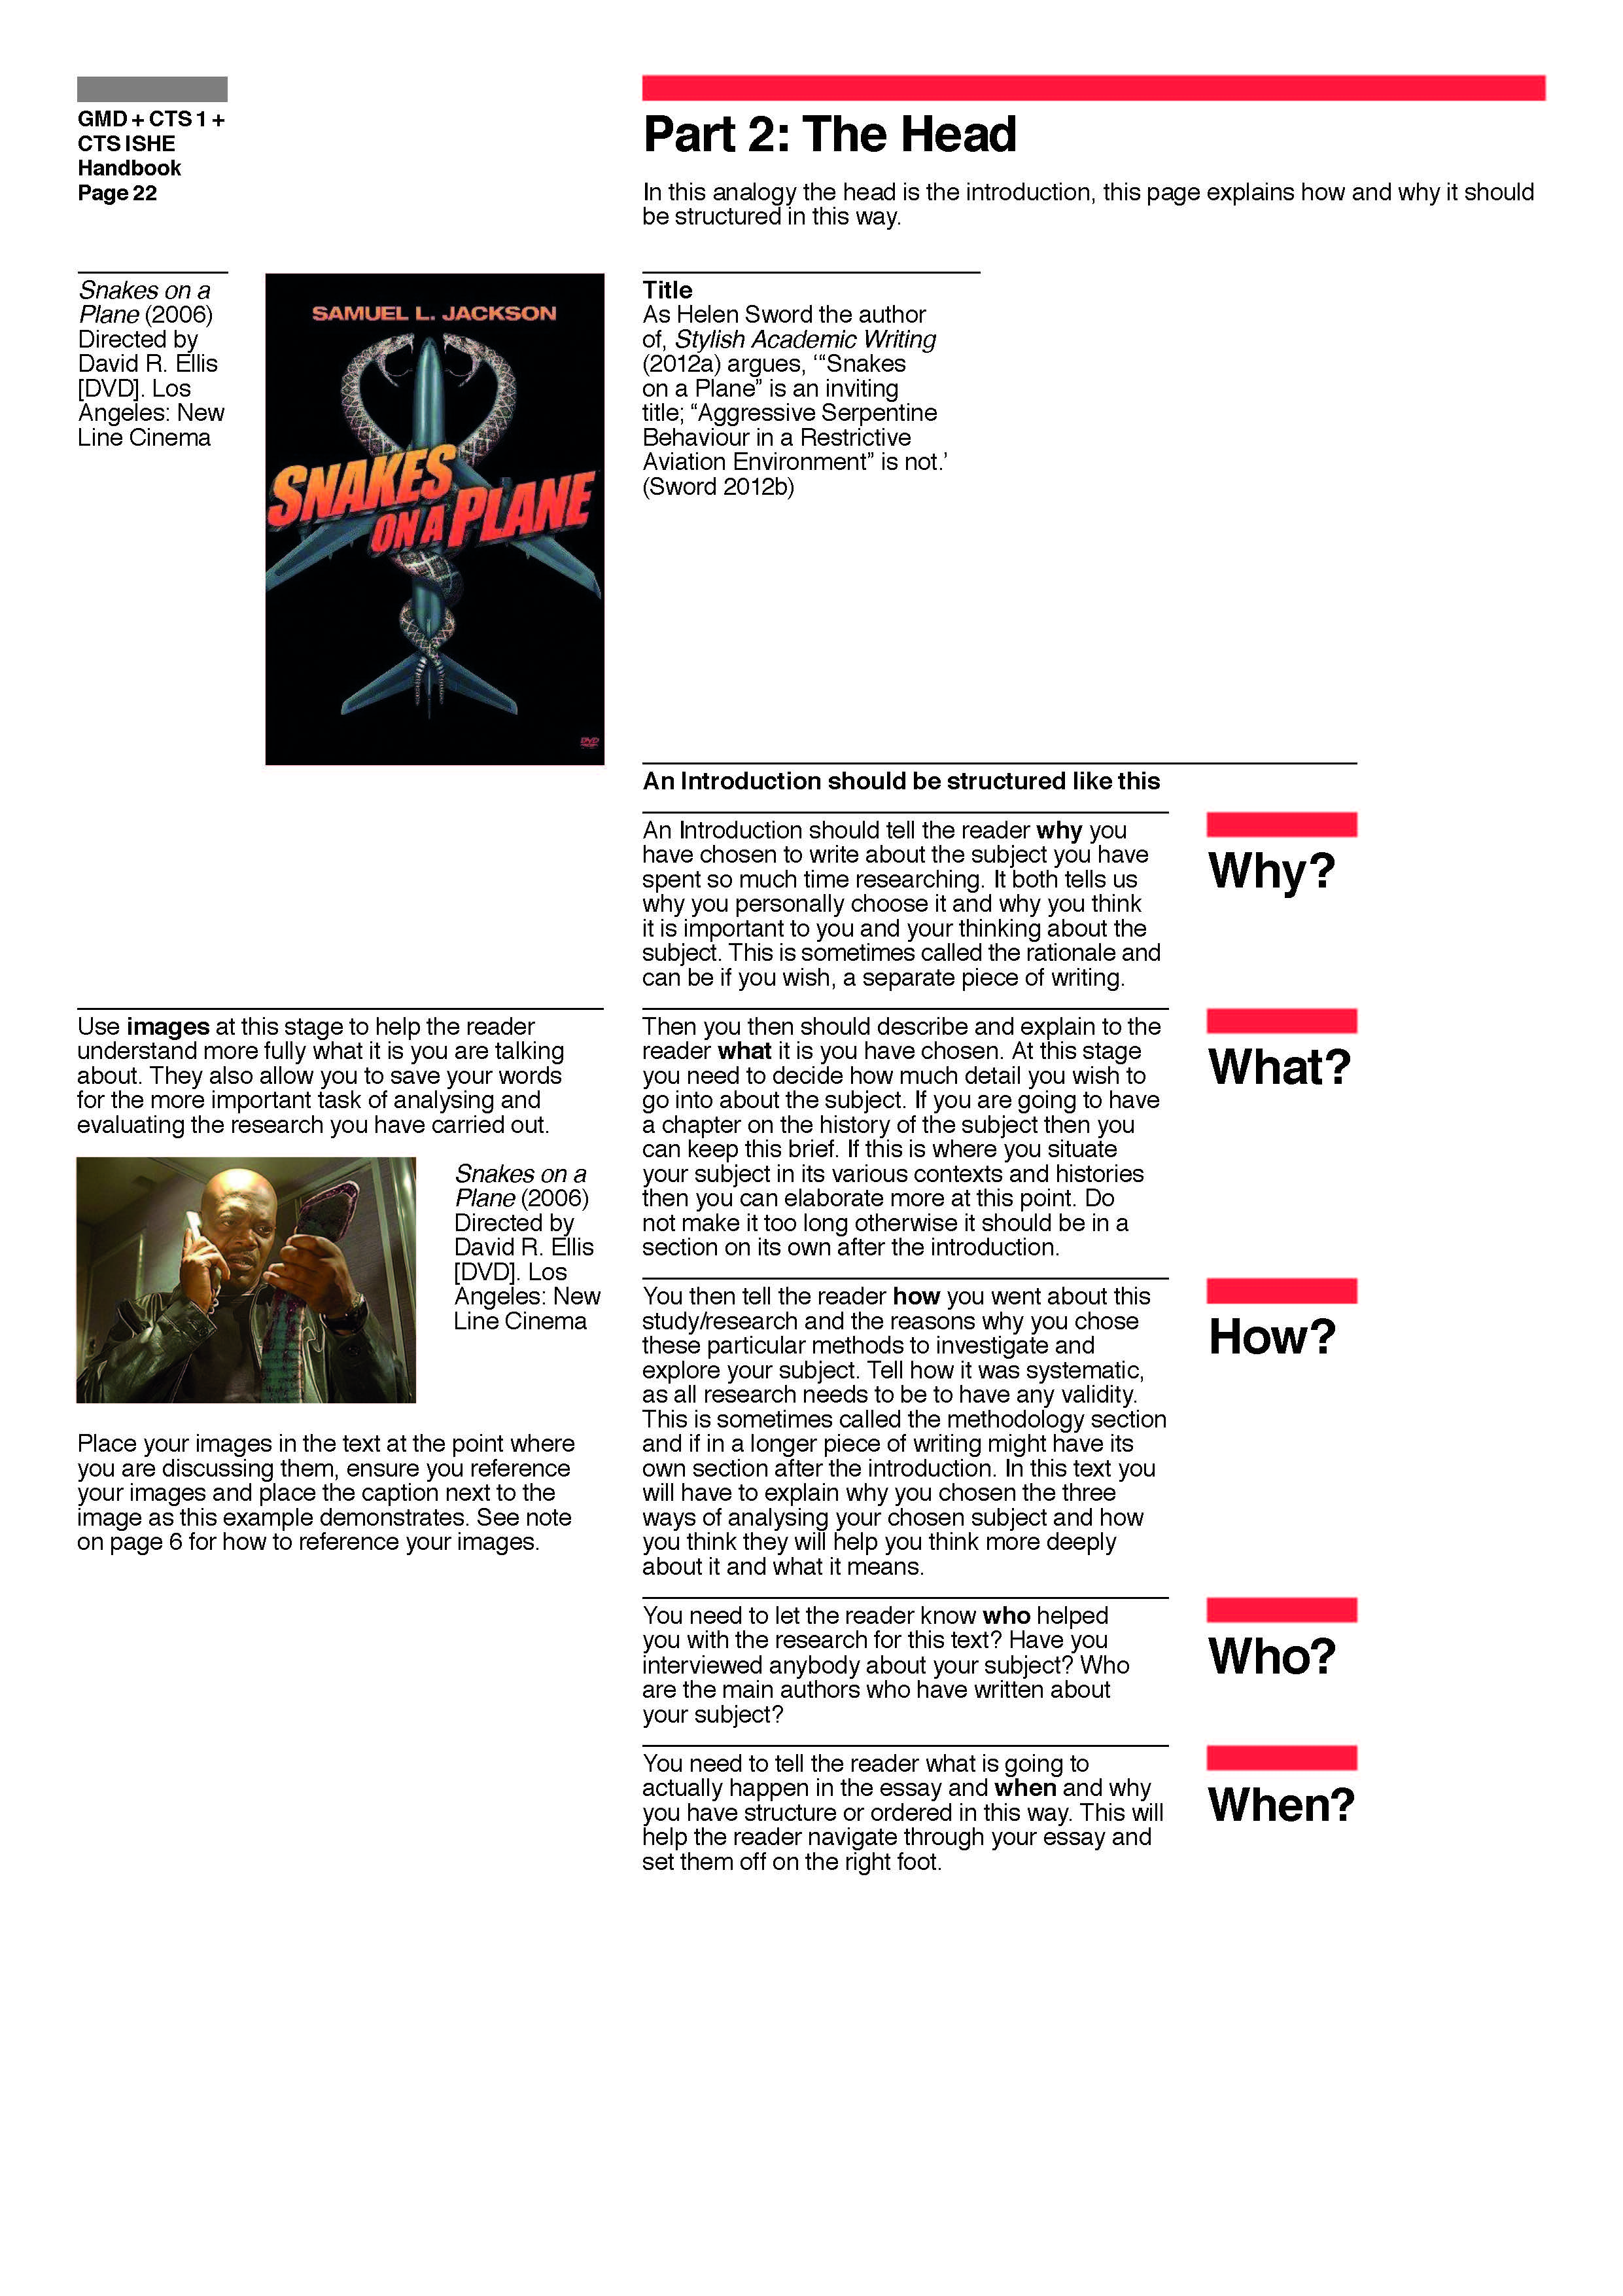

Slide 19
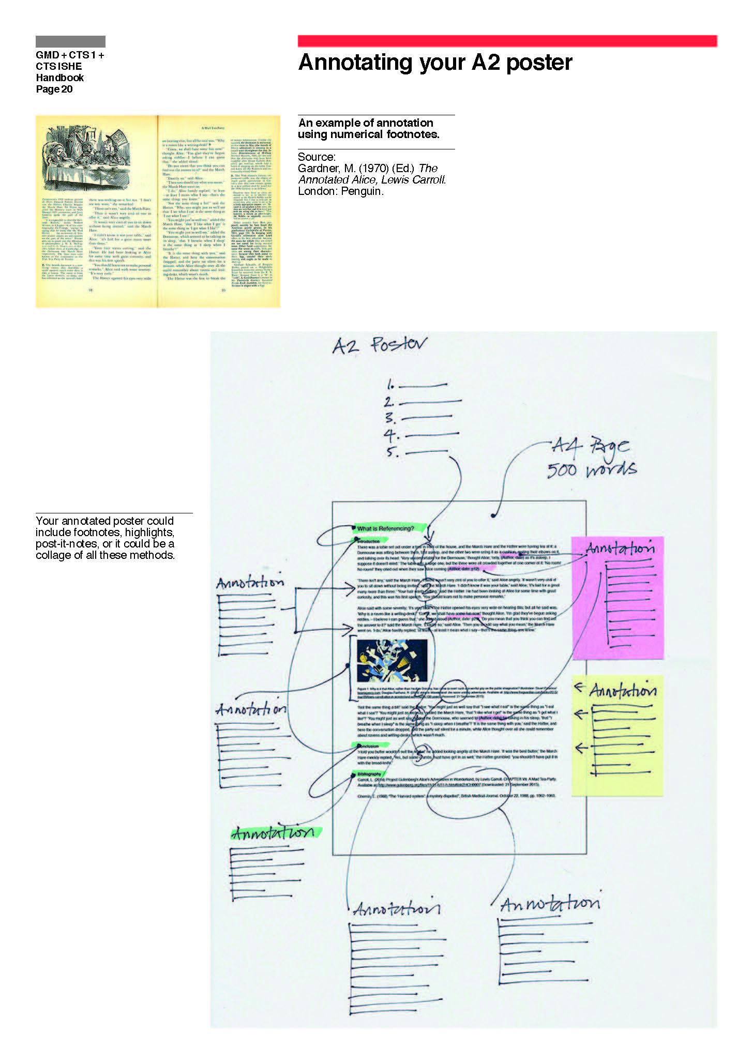

Slide 20
A closer look at Helen Sword’s Stylish Academic Writing
Look at ideas of ‘agency’ in writing ‘academically’
Who is talking to whom?

Slide 21
Seven secrets of stylish academic writing
http://theconversation.com/seven-secrets-of-stylish-academic-writing-7025

Slide 22
‘Be human: Remember you are a human being writing for other human beings.
Whether or not you employ the personal pronoun “I”, cultivate an authoritative yet conversational voice that invokes confidence and trust.
Read a few paragraphs aloud to yourself or to a friend. Do your sentences sound as though they’ve been produced by a robot? Or can you hear a real person speaking?

Slide 23
Narrative trust
https://www.timeshighereducation.com/features/narrative-trust/421045.article

Slide 24
‘Tim Appenzeller, chief magazine editor at Nature, urges academics to loosen up and let themselves into the picture:
"Academics feel they have to keep themselves out of their writing. It's part of what I think is scientists' self-image - that science is this completely objective process. So they write that way, with a passive voice. No sense that there was a mind behind the research - who thought this, who tried that - and I think that really works against the accessibility and quality of academic writing.

Slide 25
"It's more than the 'I'.
It's the sense that it is a personal exploration. A bit more of that feeling, I think, makes scientific writing a lot more approachable."’

Slide 26
Followed by a group discussion seminar about any thoughts raised.

