Slide 1
‘Thinking Design’
Mark Ingham
LCC Design School Teaching and Learning Innovation Lead
and
UAL Teaching Scholar

Slide 2
For the tenure as UAL Teaching Scholar I would like to develop a scheme that continues my interest into meta-cognitive learning as in the meta-project,
‘What is Referencing?’

Slide 3
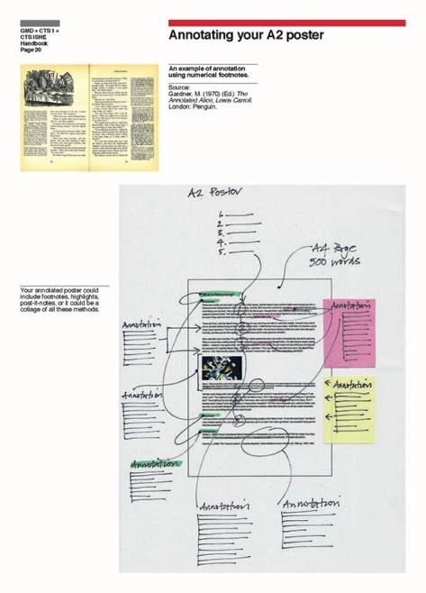

Slide 4


Slide 5
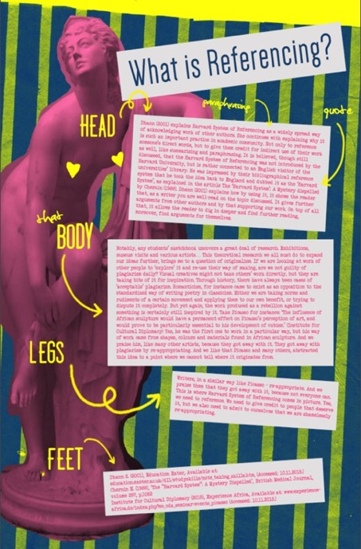

Slide 6


Slide 7
In this project metacognition refers to ‘…higher order thinking, which involves active control over the cognitive processes engaged in learning.’ (Livingston 1997).
It will be an investigation into ways of we can help students of all levels of knowledge acquisition to understand how they think about their learning.

Slide 8
As Ryan Hargrove (2011) suggests in his article Fostering creativity in the design studio: A framework towards effective pedagogical practices, ‘The area of metacognition can be the scaffolding for future problem solving, as the goal remains to enable designers to utilize creative design thinking/processes with optimum efficiency.’
https://www.pratt.edu/uploads/creativity_and_meta-cognition.pdf

Slide 9
‘Thinking Design’ will be in three main parts.
The first part will be about how we think about design to help us teach design even more effectively.

Slide 10
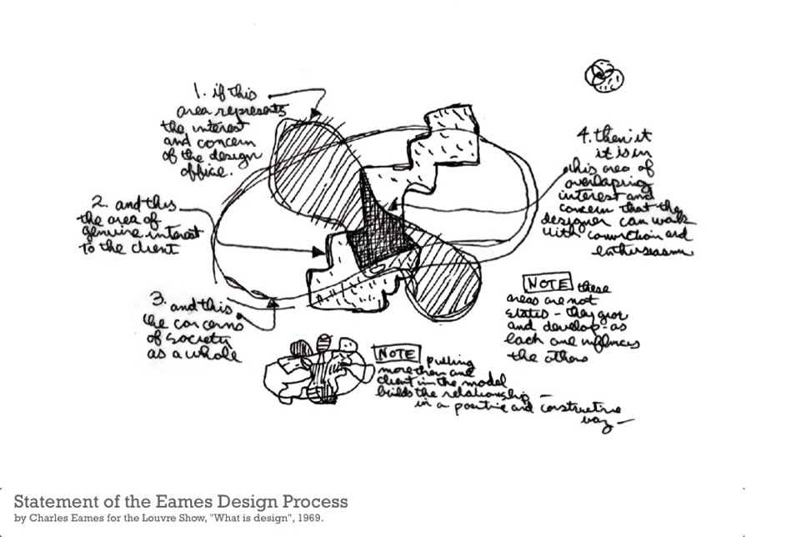

Slide 11
The second will be about how we design thinking so we can teach all aspects of the design curriculum more effectively.

Slide 12


Slide 13
The third will be about design as thought.
Going beyond the contestable ideas of ‘learning styles’ (Curry 1990) and look more deeply into the ways we can think about meta-cognitive learning.

Slide 14
This project has a number theoretical and practical strands or frames (Bal 2002).
The first frame being a philosophical approach which will use as a starting point the key concept The Image of Thought as discussed by Gilles Deleuze (1997)
in Chapter 3 of his 1968 book Difference and Repetition.

Slide 15
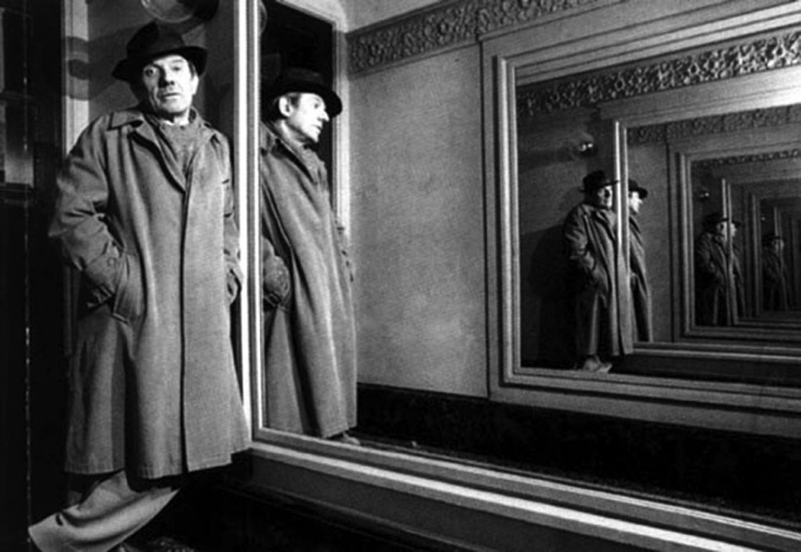

Slide 16
“An image of thought called philosophy has been formed historically and it effectively stops people from thinking.”
Gilles Deleuze, Dialogues II

Slide 17
This illuminating and complex philosophical tract has been used successfully by a number of my undergraduate students when they have started to question their own thoughts about the way they think about the topics in their thesis.

Slide 18


Slide 19
By questioning what we think thinking is, or philosophical has been thought of as thinking, these students, after an initial conceptual wrestling match, gained a much better understanding that we cannot base thinking on the concept that just because ‘…Everybody [seems to] know, [something] no one can deny, [it]…’ (Deleuze 1997:130).

Slide 20
An example of this use of a philosophical meta-cognitive strategy was Abigail Buchan, a Year 3 GMD student, who wanted to explore the idea around the representation of dinosaurs.
She investigated how we know what dinosaurs looked like and how illustrations of them influence our thinking about what they might or might not have looked like.

Slide 21
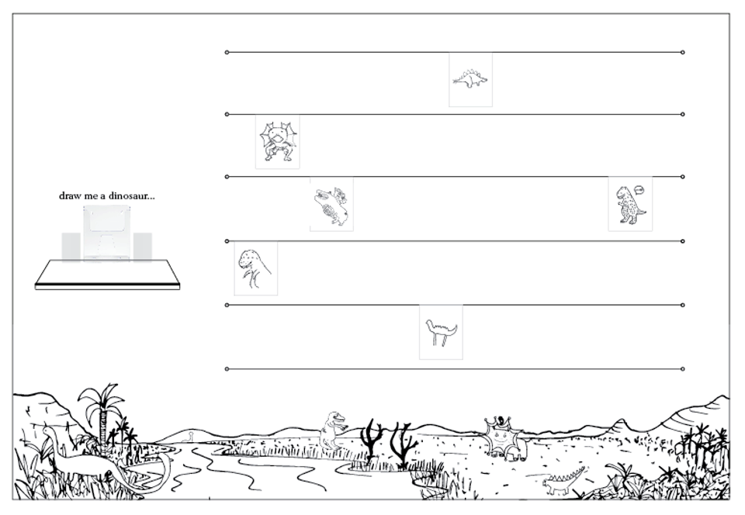

Slide 22
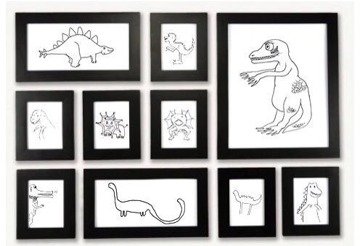

Slide 23
Her thesis developed Deleuzian ideas from ‘The Image of Thought’ to create an argument about past thinking about a subject being sometimes inhibiting to contemporary thinking about that subject.

Slide 24
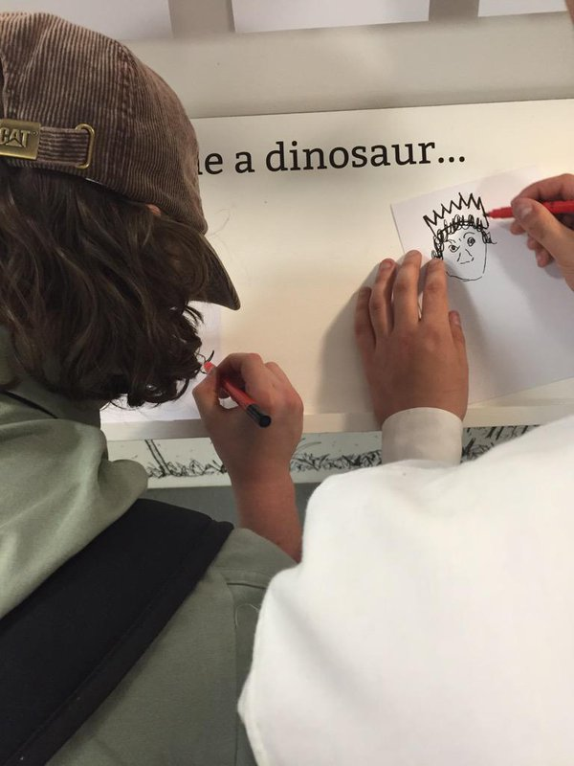

Slide 25
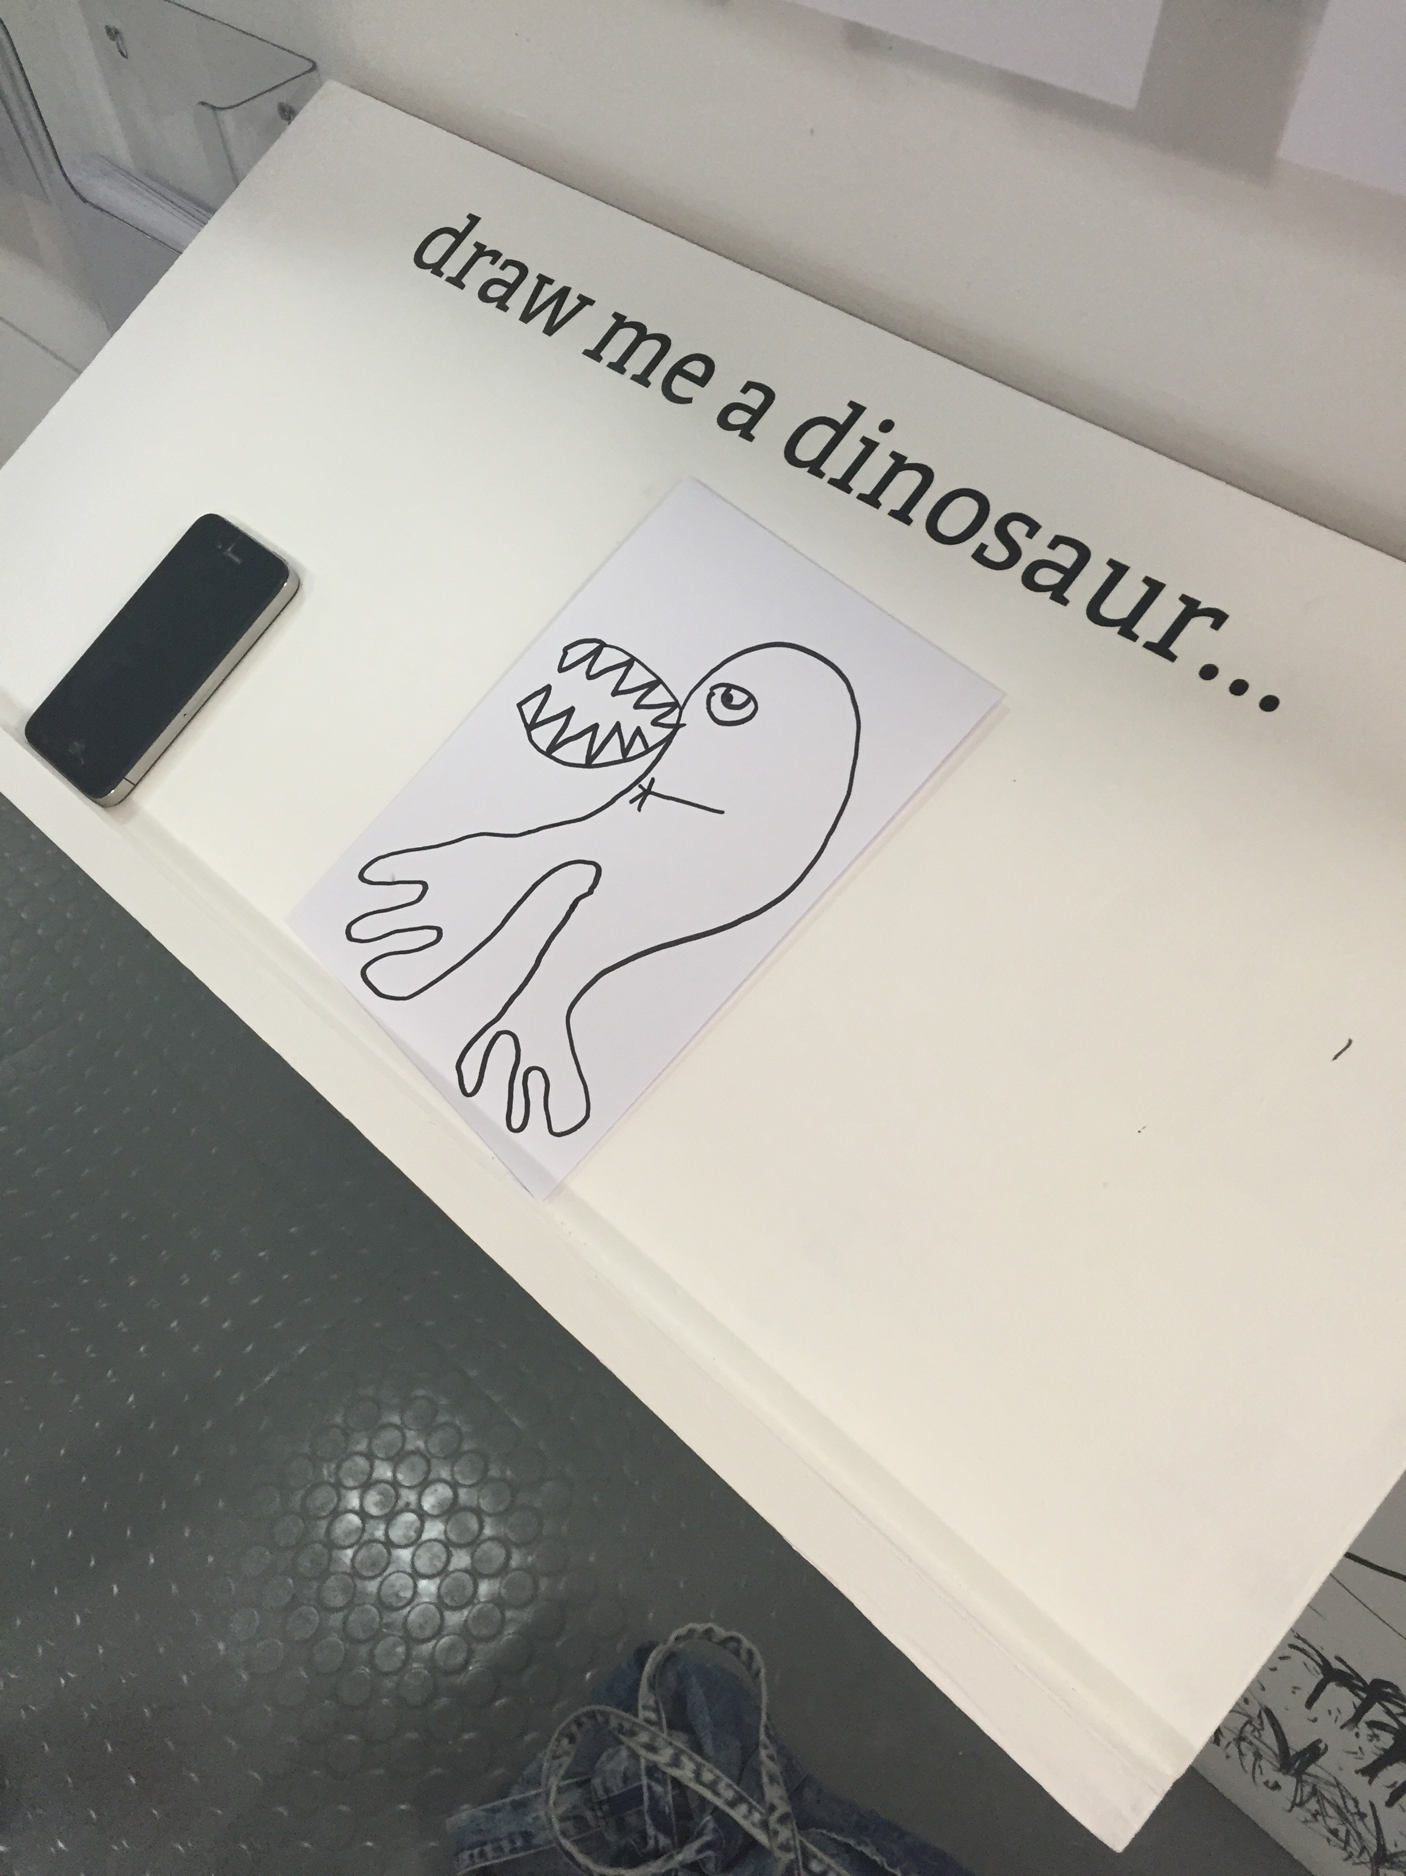

Slide 26
The success of this investigation was in the way complex philosophical ideas were used to connect theoretical practice with practice in the studio.
Abigail now works for Amazon Design and she has said that it was in part her thesis that got her the job. Even more remarkably this thesis has been passed around her department as an exemplar of creative ways of thinking about design.

Slide 27
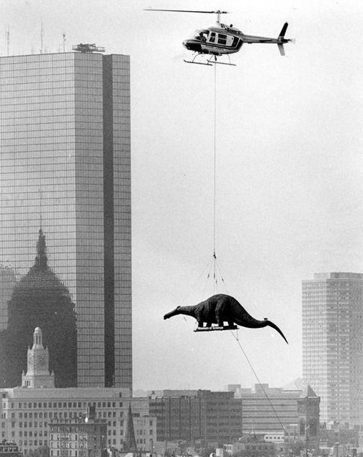

Slide 28
Another ‘frame’ would be how ‘Thinking Design’ can help the integration of theory with practice and vice a versa.
By developing a series of workshops over the two years of being a UAL Teaching Scholar, I would like to develop a number of interventions into the curriculum in the Design School that help the relationships between the theories of practice and the practices of theories develop into an even more productive synergy.

Slide 29
Thinking Design’ will aim to boost all students’ engagement with their learning at LCC but it will in particular be aimed at students who have difficulties in adapting to the way we teaching art, design and media at UAL.
By helping students actively take more control over their cognitive processes and by exposing them to deeper thinking about their learning, the objectives of this project are to make it easier for students to learn creatively and critically.

Slide 30
Bal, M. (2002 )Travelling Concepts in the Humanities: A Rough Guide. University of Toronto Press.
Buchan, A. (2015) draw me a dinosaur. https://www.facebook.com/abimaedesign/?hc_ref=PAGES_TIMELINE&fref=nf
Curry, L. (1990) A Critique of the Research on Learning Styles.
http://www.ascd.org/ASCD/pdf/journals/ed_lead/el_199010_curry.pdf
Deleuze, G. (1997) Difference and Repetition. The Athlone Press. London.
Hargrove, R. (2011) Fostering creativity in the design studio: A framework towards effective pedagogical practices. Art, Design & Communication in Higher Education. Volume 10 Number 1.
Intellect Ltd Article. https://www.pratt.edu/uploads/creativity_and_meta-cognition.pdf
Miguel Desport (2015) CTS | REFERENCING POSTER https://migueldesport.wordpress.com/2015/11/16/cts-referencing-poster/
Sutton Trust (2014) What makes great teaching? Review of the underpinning research. http://www.suttontrust.com/wp-content/uploads/2014/10/What-Makes-Great-Teaching-REPORT.pdf

